Slide 1
UBER Data
EDA + Cluster analysis
A guide by Helmi Chaaba & Daniel Smadja

Slide 2
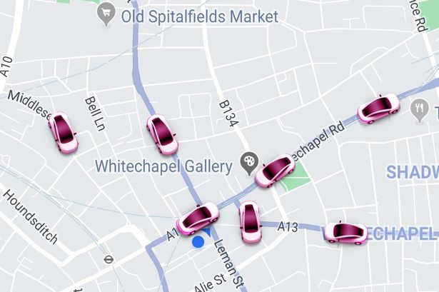
Our data
Time data: may 2014 hour per hour
Geographical data: Latitude and Longitude (float)
Our goal
Locate the most popular pick up spots in NYC

Slide 3
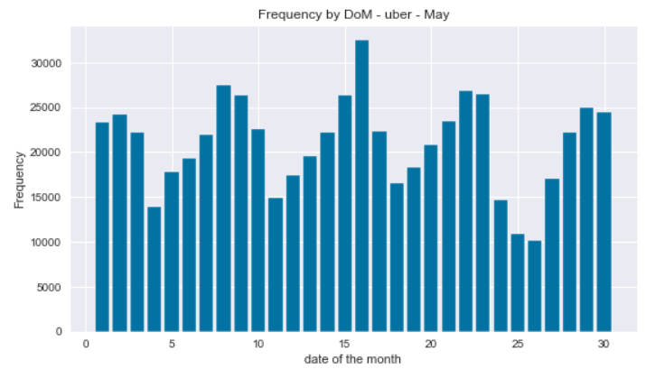
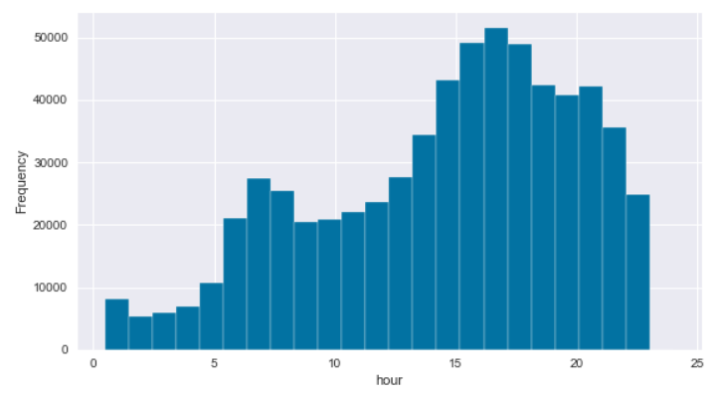
Exploratory Data Analysis

Slide 4
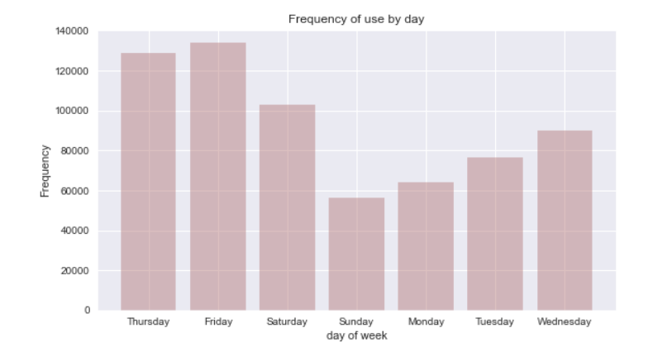
Exploratory Data Analysis

Slide 5
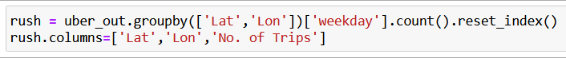
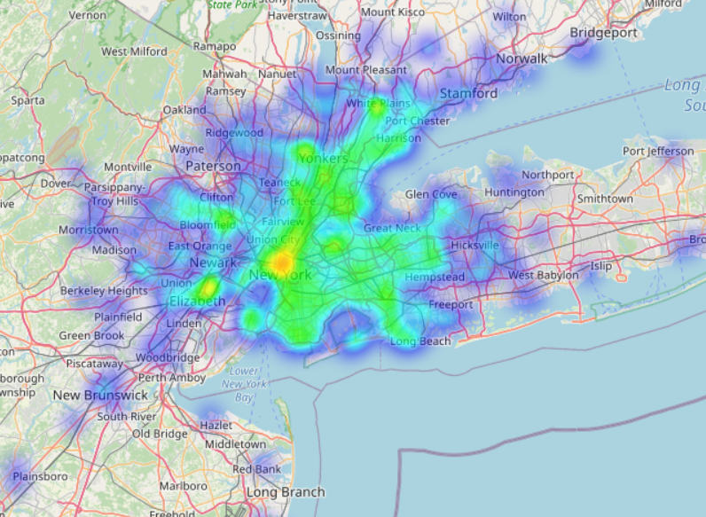
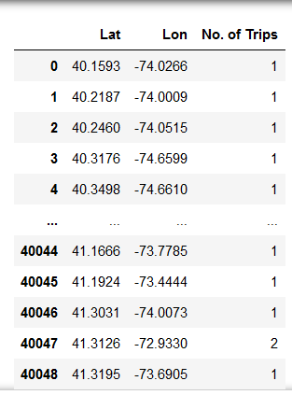
Rush hour heatmap by distance

Slide 6
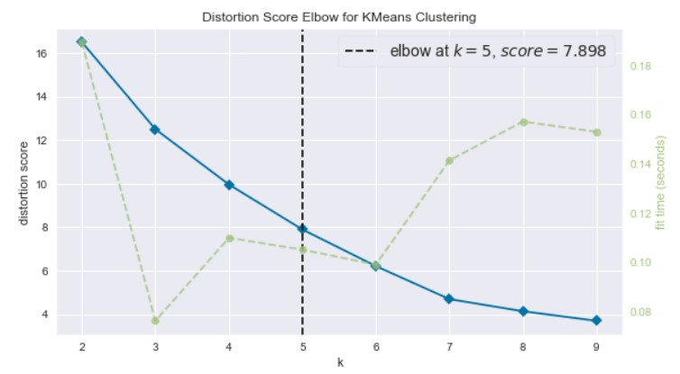
Elbow for K-Means model (k=5)

Slide 7
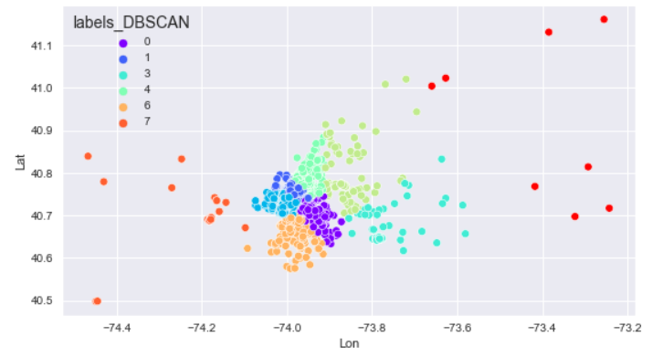
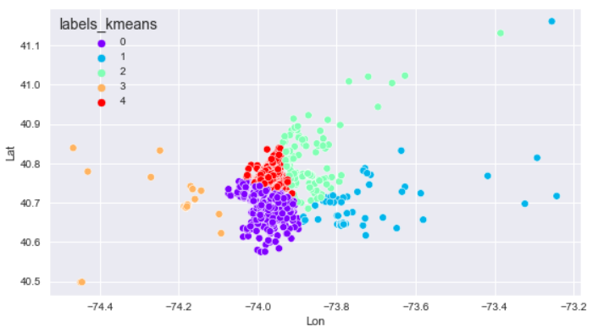
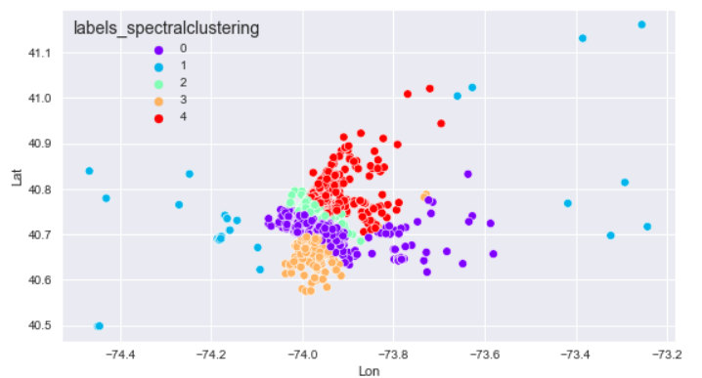
K-Means vs DBSCAN vs Spectral Clustering

Slide 8
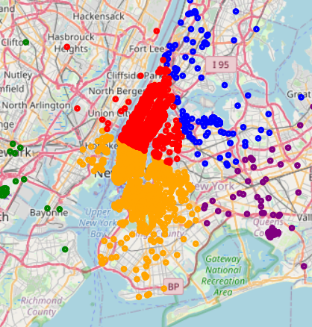
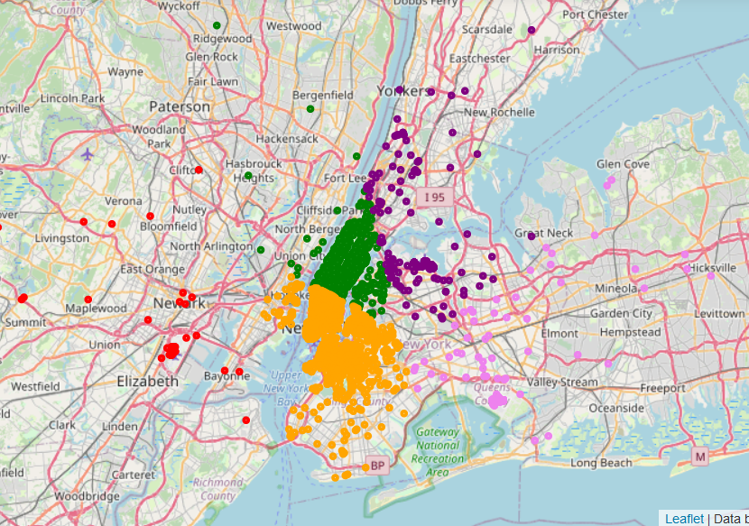
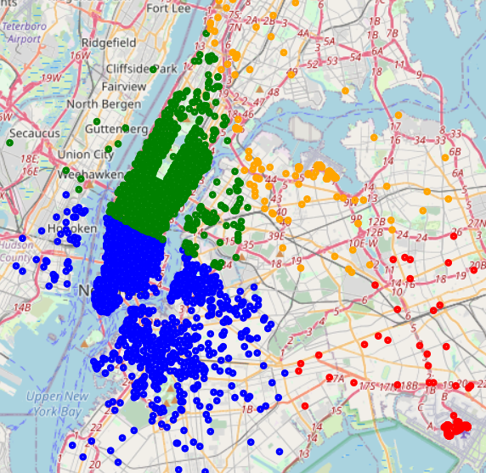
K-Means vs DBSCAN vs GMM

Slide 9
Questions????

